Slide 1
Python

Slide 2


Slide 3

30 Days Python Master Class
Day1 : Python
Time: 6.00 PM IST
Free Registration

Slide 4
Python Master Class
Handbook

Slide 5
NANDHINI.S
Exp: 5 Yrs
Expert in
Python Developer on Machine Learning
Deep learning with computer vision
Matlab – Image Processing
Autonomous Car design using ROS with LIDAR
Language – Python , Java , HTML ,CSS.
Tools – ANACONDA NAVIGATOR, JUPYTER NOTEBOOK,
GOOGLE COLAB.
Graduation : BE – ECE | 2011

Slide 6
Pantech?
Educational Equipment Manufacturer
IoT, AI, Robotics,Autonomous Robot
Microprocessor/Microcontroller
DSP,VLSI, Embedded System
Power Electronics & Drives, Fuel Cell Trainer Kit
Renewable Energy Lab, Electric Vehicle Lab
Technical Training
DIY Project

Slide 7

What is Master Class ?
👍 This is the 30 Days Industrial Learning Activity.
👍 Its Online YouTube Live Class
👍 If you Invest 45 minutes daily, U will become Master in Data Science
👍 You will get FREE E-Certificate
Webinar Participation Certificate
“Learning is the beginning of wealth.
Searching & Learning is where the miracle process all begins.” …………….Jim Rohn

Slide 8
Our Vision
Help 10 Million Students to Learn the Technology in Easy Way

Slide 9

Associate Partner for this Master Class
https://apssdc.in/home/

Slide 10
What U will Learn from 30 Days Data Science & Analytics Master Class

Slide 11
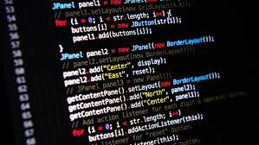
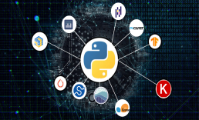

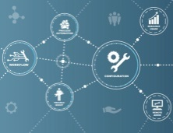
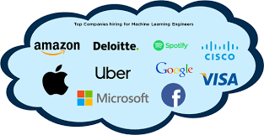
Python Learning Plan
01
02
03
04
05
Library
Python
Analytics
Analytics
Industry Project
Introduction To Python and Python Data Structures
Pandas
Numpy
MatplotLib
Cborn, SKLearn Lib
Collab
Distribution
Visualization
Aggregation
Statistics
Distribution Function
Project Building

Slide 12
Day wise Learning Plan
Day -1 : Introduction to Python
Day -2: Python – Tools|Syntaxes & Data Structures
Day -3: Python – Dictionaries,Date and Time
Day -4: Python – MySql
Day -5: Pandas library – Introduction
Day -6: Pandas library – Data Structures
Day -7: Numpy library – Introduction
Day -8: Numpy library – Array Manipulations, Mathematical Functions
Day -9: Matplotlib , Histogram Using Matplotlib | I/O With Numpy
Day -10: Matplotlib Library - Introduction , Pyplot API | Types Of Plots
Day -11: Seaborn Library
Day -12: SKLearn Library
Day -13: Python – Date and Time , Data Wrangling.
Day -14: Python – Data Cleansing
Day -15: Python – Word Tokenization , Stemming and Lammetization.

Slide 13
Day wise Learning Plan
Day -16: Python – Data Visualization
Day -17: Python – Statistical Analysis
Day -18: Python – Types Of Distribution
Day -19: Python – Correlation ,Chi-Square Test , Linear Regression
Day -20: Keras library – Introduction.
Day -21: Stock Price Prediction With Machine Learning LSTM RNN
Day -22: People’s behaviour in chat message using NLP NLP
Day -23: Gaming In Python
Day -24: Chatbot creation in Python NLP
Day -25: Electricity Price Prediction Using ML Random Forest Regressor
Day -26: Diamond Price Prediction Using Python Linear Regression
Day -27: Book Recommendation System KNN
Day -28: Image Classification Using CNN CNN
Day -29: Titanic Survival Analysis Using ML Logistic Regression
Day -30: Blockchain in Python

Slide 14
List of Projects for Demo in YouTube Live
Stock Price Prediction With Machine Learning
People’s behaviour in chat message using NLP
Gaming In Python
Chatbot creation in Python
Electricity Price Prediction Using ML
Diamond Price Prediction Using Python
Book Recommendation System
Image Classification Using CNN
Titanic Survival Analysis Using ML
Blockchain in Python
All Projects in Jupyter Notebook

Slide 15
What you will get from this Free 30 Days Master Class?
You can attend YouTube Live Class
Free E-Certificate ( WEBINAR PARTICIPATION CERTIFICATE)

Slide 16
How to mark your Attendance in YouTube Live Class?
Ans : During the Live Class, organizer will post Google Form link in Live Chat. The Participants should submit the from on daily basis. Minimum 25 Days Attendance is Required to get Free Master Class Participation Certificate.
Note : The Link will be available during the Live. From the LIVE Class date, the live video will get removed from the YouTube in 3 days.

Slide 17
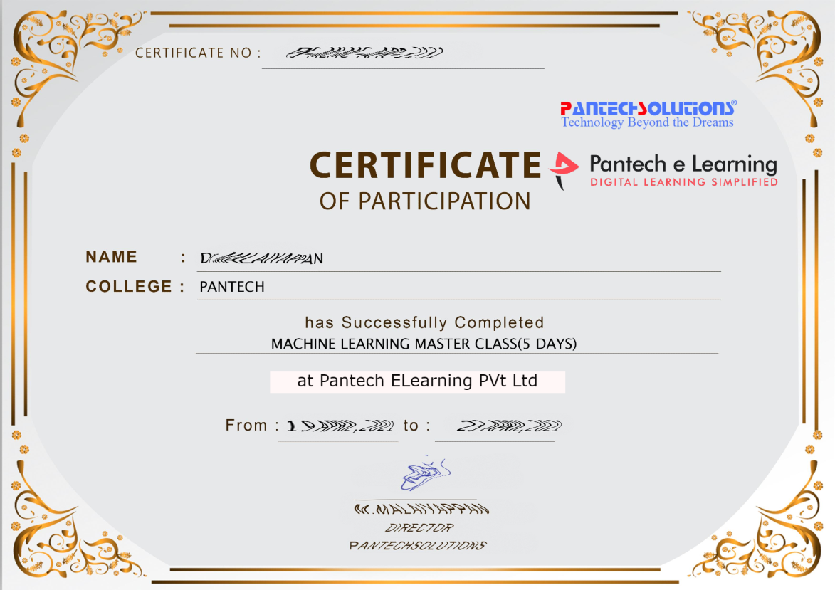

Sample Webinar Participation Certificate?

Slide 18
https://www.pantechelearning.com/data-science-master-class/
On Demand
You can get chance to apply 1 Month Internship on Data Science & Analytics Master Class

Slide 19
What is Internship????
Learn
Practice
Verify
Get Certified
Grow

Slide 20
Free Master Class DSA | 1 Month Internship on DSA
Master Class Participation Certificate | Internship Completion Certificate
Minimum 25 Class should attend YouTube Live | Recorded Class Link will be provided. – LMS Portal Access
YouTube Live Mandatory | Your Choice. You can attend Live or else You can watch Recorded Class in LMS Portal
All Projects Demo class in YouTube Live | Step by Step Video Explanation Content in LMS Portal
Access : 3 Days | VIP WhatsApp Group Support
 | You Can Download All PPTs
 | 4 Nos of Hackathon Class in Zoom Live. The Recording also will be provided
 | You Can Download All Project Files
 | Mentor will guide you to finish 10 Projects
 | Access : 60 Days

Slide 21
Pantech will make you to Create 10 Projects in Data Science & Analytics in 30 Days
Objective of this 30 Days Master Class

Slide 22
1 Month Internship in Data Science
INTERNSHIP E-Certificate(30Days Internship on Data Science Engineering)
Highly organized Video content
Download All Files
Download PPTs
Assignments
Flexible Time.
Access Period: 60Days from the date of payment

Slide 23
What You Will Get???
Complete Project Files
30 Days Learning Activity
Data Science Core Concepts
10 + Projects
Project PPT
Spatial Data Science For Covid-19 Disease Prediction
Parkinson’s Disease Prediction-XGBoost Classifier
House Price Prediction-Random Forest Regression
Customer Segmentation Using ML-K-Means Clustering
Home Loan Prediction-Decision Tree Classifier
Spam Classification-NLP
Hand Written Digit Recognition Using Python-CNN
Churn Prediction-Deep Learning
Crop Yield Prediction
Ground water level prediction
Video Class Access for 2 Months
Get chance to Enroll 1-Month Internship on demand

Slide 24
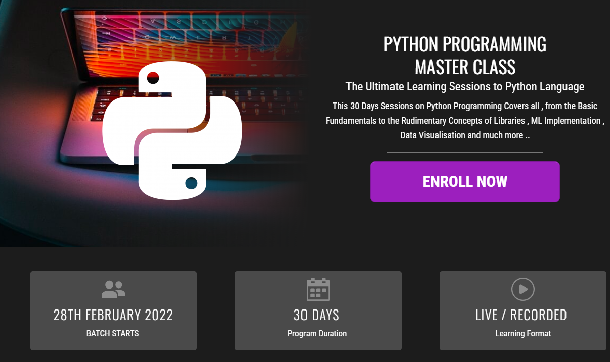
How to join in 1 month Internship
https://www.pantechelearning.com/pymc-internship/
Coupon Code: PYMC

Slide 25
What Is Python?
Python is a high-level and object-oriented programming language.
It was developed by Guido Van Rossum during 1990’s.
It is available under the General Public Licence(GPL).

Slide 26
Why Python?
Python is an interpreted and object-oriented scripting language.
Improves code readability and it uses many English Keywords.
Other languages use many punctuations and it has a simple syntax when compared to other languages.
It is mainly used in the web development domain.

Slide 27
Advantages:
It is processed at runtime by the interpreter.
Python is interactive.
One can interact with the interpreter to directly write our programs.
Python supports object-oriented style of programming.
It is a good language for beginner-level programmers.

Slide 28
Reasons To Learn Python:
It supports both structured as well as functional programming methods.
It can be used as a scripting language or it can be compiled to byte code for building large applications.
It provides high-level dynamic data types and supports automatic garbage collection.
It can be integrated with other languages like C,C++,CORBA and JAVA.

Slide 29
Applications Of Python:
Easy To Learn: It has few keywords and a clearly defined syntax.
Easy To Read and Maintain: It is clearly defined and easy to maintain.
Interactive and Portable: It supports interactive mode and it can run on a variety of platforms.
GUI Programming: It supports many GUI applications.
Scalable: Provides better structure and it can run large programs.

Slide 30
Python – Dictionary:
Each key is separated from the value by a colon.(:)
The items are separated by commas and the whole thing is enclosed by curly braces{}.
An empty dictionary without any items is written with just two curly braces:{}.
Keys are unique within a dictionary and the values are not unique.
The values of a dictionary can be of any type.
The keys must be an immutable data type like strings , numbers or tuples.

Slide 31
Accessing Values inside a Dictionary:
To access the dictionary elements , we use the square brackets along with the key to obtain the value.
dict = {'Name': 'Zara', 'Age': 7, 'Class': 'First'}
print ("dict['Name']: ", dict['Name'])
print( "dict['Age']: ", dict['Age'])
Output:
dict['Name']: Zara
dict['Age']: 7

Slide 32
Updating Dictionary
Dictionaries can be updated by adding a new entry or a key value pair.
Existing entries can be modified or it can be deleted.
dict = {'Name': 'Zara', 'Age': 7, 'Class': 'First'}
dict['Age'] = 8; # update existing entry
dict['School'] = “PPS School"; # Add new entry
print "dict['Age']: ", dict['Age']
print "dict['School']: ", dict['School']

Slide 33
Output:
dict['Age']: 8
dict['School']: DPS School

Slide 34
Delete the Dictionary elements:
We can remove the individual dictionary elements or clear the entire contents of a dictionary.
The entire dictionary can also be deleted in a single operation.
To remove an entire dictionary , use the del statement.
dict = {'Name': 'Zara', 'Age': 7, 'Class': 'First'}
del dict['Name']; # remove entry with key 'Name'
dict.clear(); # remove all entries in dict
del dict ; # delete entire dictionary
print ("dict['Age']: ", dict['Age'] )
print ("dict['School']: ", dict['School'])

Slide 35
Output:
dict['Age']:
Traceback (most recent call last):
File "test.py", line 8, in <module>
print "dict['Age']: ", dict['Age'];
TypeError: 'type' object is unsubscriptable

Slide 36
Properties Of Dictionary Keys:
Dictionary values have no restrictions.
They can be any arbitrary python object , either standard object or user – defined object.
Same is not true for keys.
There are two points to know about dictionary keys:
(a) More than one entry per key is not allowed.
No duplicate keys are allowed.
When duplicate keys are encountered during assignment , the last assignment wins.

Slide 37
Example:
dict = {'Name': ‘Sam', 'Age': 7, 'Name': ‘John'}
print ("dict['Name']: ", dict['Name'])
Output:
dict['Name']: John

Slide 38
Properties Of Dictionary Keys:
(b) Keys must be immutable.
It means that anything like Strings , lists and Tuples can be used as dictionary key but something like [‘key’] is not allowed.
Consider the following example:
dict = {['Name']: ‘Ricky', 'Age': 7}
print ("dict['Name']: ", dict['Name'])
Output:
Traceback (most recent call last):
File "test.py", line 3, in <module>
dict = {['Name']: ‘Ricky', 'Age': 7};
TypeError: unhashable type: 'list'

Slide 39
Built-In Dictionary Functions and Methods:
Python contains the following dictionary functions:
Cmp(dict1,dict2):
Compares the elements of the two dictionary.
Len(dict):
It gives the total length of the dictionary.
This would be equal to the number of items in the dictionary.
Str(dict):
Produces a string representation of the dictionary.

Slide 40
Built-In Dictionary Functions and Methods:
Type(variable):
Returns the type of the passed variable.
If the passed variable is a dictionary , then it would return a dictionary type.

Slide 41
Dictionary Methods:
Python includes the following dictionary methods:
dict.clear():
Removes all the elements of the dictionary.
dict.copy():
Returns a shallow copy of the dictionary dict.
dict.fromkeys():
Creates a new dictionary with keys from sequence and values set to value.

Slide 42
Dictionary Methods:
Dict.has_key(key):
Returns true if the key is in the dictionary or it returns false.
Dict.items():
Returns a list of dict’s(key,value) tuple pairs.
Dict.keys():
Returns a list of dictionary keys.
Dict.update(dict2):
Adds dictionary dict2’s key-value pairs to dictionary.
Dict.values():
Returns a list of dictionary dict’s values.

Slide 43
Python – Date and Time
In data science , we need analysis which is based on temporal values.
Python can handle various formats of date and time.
The datetime library provides the essential methods and functions.
Date Time Representation
Date Time Arithmetic
Date Time Comparison

Slide 44
Python – Date Time Representation
A date and its various parts are represented by different datetime functions.
Format specifiers are used to display the alphabetical parts of a date like name of the month or week day.

Slide 45
Python – Date Time Representation
import datetime
print ('The Date Today is :', datetime.datetime.today())
date_today = datetime.date.today()
print (date_today)
print ('This Year :', date_today.year)
print ('This Month :', date_today.month)
print ('Month Name:',date_today.strftime('%B'))
print ('This Week Day :', date_today.day)
print ('Week Day Name:',date_today.strftime('%A'))

Slide 46
Date Time Representation - Output
The Date Today is : 2018-04-22 15:38:35.835000
2018-04-22
This Year : 2018
This Month : 4
Month Name: April
This Week Day : 22
Week Day Name: Sunday

Slide 47
Python – Date Time Arithmetic
In order to do various operations related to dates , the dates are stored in different variables.
Then , the relevant mathematical operator are applied to those variables.

Slide 48
Python – Date Time Arithmetic
import datetime
#Capture the First Date
day1 = datetime.date(2018, 2, 12)
print ('day1:', day1.ctime())
# Capture the Second Date
day2 = datetime.date(2017, 8, 18)
print ('day2:', day2.ctime())
# Find the difference between the dates
print ('Number of Days:', day1-day2)

Slide 49
Python – Date Time Arithmetic
date_today = datetime.date.today()
# Create a delta of Four Days
no_of_days = datetime.timedelta(days=4)
# Use Delta for Past Date
before_four_days = date_today - no_of_days
print ('Before Four Days:', before_four_days )
# Use Delta for future Date
after_four_days = date_today + no_of_days
print ('After Four Days:', after_four_days )

Slide 50
Date Time Arithmetic - Output
day1: Mon Feb 12 00:00:00 2018
day2: Fri Aug 18 00:00:00 2017
Number of Days: 178 days, 0:00:00
Before Four Days: 2018-04-18
After Four Days: 2018-04-26

Slide 51
Output
day1: Mon Feb 12 00:00:00 2018
day2: Fri Aug 18 00:00:00 2017
Number of Days: 178 days, 0:00:00
Before Four Days: 2021-12-12
After Four Days: 2021-12-20

Slide 52
Python – Date Time Comparison
Date and time are compared using logical operators.
One must be careful in comparing right parts of the dates with each other.

Slide 53
Date Time Comparison
import datetime
date_today = datetime.date.today()
print ('Today is: ', date_today)
# Create a delta of Four Days
no_of_days = datetime.timedelta(days=4)
# Use Delta for Past Date
before_four_days = date_today - no_of_days
print ('Before Four Days:', before_four_days)
after_four_days = date_today + no_of_days
date1 = datetime.date(2018,4,4)

Slide 54
Date Time Comparison
print ('date1:',date1)
if (date1 == before_four_days):
print ('Same Dates’)
if (date_today > date1):
print ('Past Date’)
if (date1 < after_four_days):
print ('Future Date‘)

Slide 55
Date Time Comparison - Output
Today is: 2018-04-22
Before Four Days: 2018-04-18
date1: 2018-04-04
Past Date
Future Date

Slide 56
Python – Date and Time:
A python program can handle date and time in several ways.
Converting between date formats is the main job of computers.
Time and calender modules of python helps track dates and times.
What is a tick?
Time intervals are floating point numbers in units of seconds.
Particular instants in time are expressed in seconds.
Time module in python provides functions for working with times.
The time.time() function returns the current time in ticks.

Slide 57
Example:
import time; # This is required to include time module.
ticks = time.time()
print ("Number of ticks since 12:00am, January 1, 1970:", ticks)
Output:
Number of ticks since 12:00am, January 1, 1970: 7186862.73399

Slide 58
Example:
Date arithmetic is easy to do with ticks.
Dates before the epoch cannot be represented in this form.
Dates in the far future cannot be represented this way.
The cutoff point is somewhere in 2038 for UNIX and Windows.
What is a Time Tuple?
Python’s time functions handle time as a tuple of 9 numbers;
Field Values
4-digit year 2008 Month 1 to 12 Day 1 to 31 Hour 0 to 23

Slide 59
Time Tuple:
Field Values
Minute 0 to 59
Second 0 to 61 (60 or 61 are leap-seconds)
Day of Week 0 to 6 (0 is Monday)
Day of year 1 to 366 (Julian day)
Daylight savings -1, 0, 1, -1 means library determines DST
The above tuple is equivalent to struct_time structure.

Slide 60
Time Tuple:
Attributes Values
tm_year 2008
tm_mon 1 to 12
tm_mday 1 to 31
tm_hour 0 to 23
tm_min 0 to 59
tm_sec 0 to 61 (60 or 61 are leap-seconds)
tm_wday 0 to 6 (0 is Monday)
tm_yday 1 to 366 (Julian day)
tm_isdst -1, 0, 1, -1 means library determines DST

Slide 61
Getting Current Time:
The time instant(from seconds since the epoch-floating point value) can be converted to time-tuple using a translation function.
The floating-point value is passed to a function(i.e , localtime) that returns a time-tuple with all nine items valid.
Example:
import time;
localtime = time.localtime(time.time())
print ("Local current time :", localtime)
Output:
Local current time : time.struct_time(tm_year=2013, tm_mon=7,
tm_mday=17, tm_hour=21, tm_min=26, tm_sec=3, tm_wday=2, tm_yday=198, tm_isdst=0)

Slide 62
Getting Formatted Time:
Time can be formatted in any form as per the requirement.
The simple method to get time in readable format is asctime().
Example:
import time;
localtime = time.asctime( time.localtime(time.time()) )
print ("Local current time :", localtime)
Output:
Local current time : Tue Jan 13 10:17:09 2009

Slide 63
Getting Calendar For a Month:
Calendar module contains a range of methods to play with yearly and monthly calendars.
Here is an example to print a calendar for a given month(2008):
Example:
import calendar
cal = calendar.month(2008, 1)
print ("Here is the calendar:" )
print (cal)

Slide 64
Output:
Here is the calendar:
January 2008
Mo Tu We Th Fr Sa Su
1 2 3 4 5 6
7 8 9 10 11 12 13
14 15 16 17 18 19 20
21 22 23 24 25 26 27
28 29 30 31

Slide 65
The Time Module:
There is a time module available in python and it provides functions for working with times.
The module is used for converting between representations.
Following is a list of all available methods:
Functions With Description:
time.altzone: The offset of local DST timezone , in seconds west of UTC , if one is defined.
time.asctime([tupletime]):Accepts a time-tuple and returns a readable 24 character string(‘Mon Dec 11 18:07:14 2008'.)
Time.clock():
Returns the current CPU time as the floating-point number of seconds.

Slide 66
The Time Module:
time.ctime([secs]):
Like asctime(localtime(secs)) and without arguments is like asctime( ).
time.localtime([secs]):
Accepts an instant expressed in seconds since the epoch and returns a time-tuple t with the local time.
time.sleep(secs):
Suspends the calling thread for secs seconds.
time.time():
Returns the current time instant, a floating-point number of seconds since the epoch.

Slide 67
The Time Module:
Following are the two important attributes available in time module.
time.timezone:
It is nothing but the offset in seconds of the local timezone.
time.tzname:
It is a pair of locale-independent strings , which are the names of the local time zone without and with DST.

Slide 68
The Calendar Module:
The Calendar module provides calendar – related functions.
It contains functions to print a text calendar for a given month or year.
By default , calendar takes Monday as the first day of the week and Sunday as the last day.
Function With Description:
calendar.calendar(year,w=2,l=1,c=6):
Returns a multiline string with a calendar for year year formatted into three columns separated by c spaces.
w is the width of the characters of each week and l is the number of lines for each week.

Slide 69
The Calendar Module:
calendar.firstweekday( ):
Returns the current setting for the weekday that starts each day.
calendar.isleap(year):
Returns true if the year is the leap year or it returns false.
Other Modules and Functions:
The datetime Module.
The pytz Module.
The dateutil Module.

Slide 70
Python – Modules:
A module allows you to logically organize your python code.
Grouping related code into module makes the code easier to understand.
A module is a python object with arbitrarily named attributes that you can bind and reference.
A module is a file that consists of python code.
A module can define function . Classes and variables.
A module can also include runnable code.

Slide 71
Example:
The python code for a module named aname resides in a file named aname.py.
Here’s an example of simple module support.py.
def print_func( par ):
print "Hello : ", par
return
The import Statement:
We can use python source file as a module by executing an import statement in some other python source file.

Slide 72
Example:
Syntax of Import Statement:
import module1[, module2[,... moduleN].
When the interpreter encounters an import statement , it imports the module present in the search path.
A search path is a list of dictionaries that the interpreter searches before importing a module.
To import the module , support .py , put the following command at the top of script.

Slide 73
Example:
#!/usr/bin/python
# import module support
import support _th
# Now you can call defined function that module as follows
Support_th.print_func(“Tom").
Output:
Hello : Tom
A module is loaded only once regardless of the number of times it is imported.
This prevents the module execution from happening over and over again.

Slide 74
The from...import Statement
Python’s from statement lets you import specific attributes from a module into the current namespace.
The from import has the following syntax:
from modname import name1[, name2[, ... nameN]] .
To import the function fibonacci from module fib , use the following statement:
from fib import fibonacci .
This module does not import the entire module fib into the current namespace.
It introduces the item fibonacci from the module fib into the global symbol table of the importing module.

Slide 75
The from...import * Statement
It is possible to import all names from a module into the current namespace.
from modname import *
This provides an easy way to import all items from a module into the current namespace.
Locating Modules:
When you import a module , the python interpreter searches for a module in the following sequences:
The current directory.

Slide 76
Locating Modules:
If the module is not found , Python then searches each directory in the shell variable PYTHONPATH.
If all else fails , Python checks the default path.
In UNIX , the default path is normally /usr/local/lib/python/.
The module search path is stored in the system module sys as sys.path variable.
The sys.path variable contains the current directory and the PYTHONPATH.

Slide 77
The PYTHONPATH Variable
The PYTHONPATH is an environment variable and it consists of a list of directories.
The syntax of PYTHONPATH is same as that of the shell variable PATH.
Here is a typical PYTHONPATH from a Windows system −
set PYTHONPATH = c:\python20\lib;
And here is a typical PYTHONPATH from a UNIX system −
set PYTHONPATH = /usr/local/lib/python.

Slide 78
Namespaces and Scoping
Variables are names(identifiers) that map to objects.
A namespace is a dictionary of variable names(keys) and their corresponding objects(values).
A python statement can access variables in the local namespace and in the global namespace.
If a local and global variable have the same name , the local variable shadows the global variable.
Each function has its own local namespace.
Class methods follow the same scoping rule as the ordinary functions.
Python makes guesses whether the variables are local or global.
It assumes that any variable assigned value in a function is local.

Slide 79
Namespaces and Scoping
In order to assign value to a global variable within a function , use the global statement.
The statement global VarName tells Python that VarName is a global variable.
Python stops searching the local namespace for the variable.
For eg , define a variable amount in the global namespace.
Within the function amount, amountis assigned with some value.
Python assumes money as the local variable.

Slide 80
Example:
#!/usr/bin/python
Amount = 2000
def Add Amount ():
# Uncomment the following line to fix the code:
# global Money
Amount = Amount + 1
print Amount
Add Amount ()
print Amount

Slide 81
The dir Function:
The dir() built in function returns a sorted list of strings.
It contains the names defined by the module.
The list contains the names of all modules. Variables and functions that are defined in the module.
Following is the simple example:
#!/usr/bin/python
# Import built-in module math
import math
content = dir(math)
print content

Slide 82
Output:
['__doc__', '__loader__', '__name__', '__package__', '__spec__', 'acos', 'acosh', 'asin', 'asinh', 'atan', 'atan2', 'atanh', 'ceil', 'copysign', 'cos', 'cosh', 'degrees', 'e', 'erf', 'erfc', 'exp', 'expm1', 'fabs', 'factorial', 'floor', 'fmod', 'frexp', 'fsum', 'gamma', 'gcd', 'hypot', 'inf', 'isclose', 'isfinite', 'isinf', 'isnan', 'ldexp', 'lgamma', 'log', 'log10', 'log1p', 'log2', 'modf', 'nan', 'pi', 'pow', 'radians', 'remainder', 'sin', 'sinh', 'sqrt', 'tan', 'tanh', 'tau', 'trunc']
The special string variable _name_ is the module’s name and _file_ is the filename from which the module was loaded.

Slide 83
The globals() and locals() Functions
The Globals() and Locals() function can be used to return the names in the global and local namespaces.
They return the names depending on the location from where they were called.
If locals() is called within a function , it will return all the names that can be accessed locally from that function.
If globals() is called within a function , it will return all the names that can be accessed globally from that function.
The return type of both theses functions is dictionary.
So , names can be extracted using the keys() function.

Slide 84
The Reload() Function:
When the module is imported into the script , the code in the top-level portion of the module is executed only once.
If we want to re-execute the top level code in the function , we can use the reload() function.
The reload() function imports a previously imported module again.
Following is the syntax of reload() function:
reload(module_name)
Module_name is the name of the module we want to reload.
For example , to reload the hello module , type the following:
reload(hello)

Slide 85
Packages In Python:
A package is a hierarchical file directory structure.
It defines a single python application environment and it consists of modules , sub-packages and sub-sub-packages.
Consider a file pots.py available in phone directory.
#!/usr/bin/python
def Pots():
print ("I'm Pots Phone“)

Slide 86
Packages In Python:
We have two files having different functions with the same name:
Phone/Isdn.py file having function Isdn()
Phone/G3.py file having function G3().
create one more file __init__.py in Phone directory.
Phone/__init__.py
To make all of your functions available when you've imported Phone, you need to put explicit import statements in __init__.py.
from Pots import Pots
from Isdn import Isdn
from G3 import G3

Slide 87
Packages In Python:
We can access all theses classes when we import the phone package.
#!/usr/bin/python
# Now import your Phone Package.
import Phone
Phone.Pots()
Phone.Isdn()
Phone.G3()

